Slide 1

Presentation on “ Youtube Spam Comment Detection” By Pranav Kolhe
Department of Computer Engineering
MPSTME, Shirpur Campus
2022-23

Slide 2
Outline
Introduction
Problem Statement
Proposed Solution
System Architecture
Data Description
Implementation
Result
Conclusion

Slide 3
Introduction
YouTube, the world’s largest video sharing site, was founded in 2005 and acquired by Google in 2006. YouTube has grown tremendously as a video content platform, with the recent shift in online content to video.
At present, more than 400 hours of video are uploaded and 4.5 million videos are watched every minute on YouTube. It is easy for users to watch and upload videos without any restrictions.
This great accessibility has increased the number of personal media, and some of them have become online influencers.
YouTube creators can monetize if they have more than 1,000 subscribers and 4,000 hours of watch time for the last 12 months. Accordingly, spam comments are being created to promote their channels or videos in popular videos.
Some creators closed the comment function due to aggression such as political comments, abusive speech, or derogatory comments not related to their videos.
YouTube has its own spam filtering system, though there are still spam comments that are not being caught.

Slide 4
Problem Statement
The popularity of YouTube not only attracted genuine viewers but spammers as well. As a result, there is an increase in unwanted spam videos and comments. Here comes the importance of an AI-based YouTube spam comment detection model.
In this AI project, you will be focusing on text and words and classify internet comments as spam or not spam. The spam detection model can be accomplished by using bag-of-words and random forest techniques.

Slide 5
Proposed Solution (Expected Outcome)
Using multiple Classification Algorithms, the model with the highest accuracy for spam detection results would be considered in our project as the best predictive model for Youtube Spam Comments Detection.

Slide 6
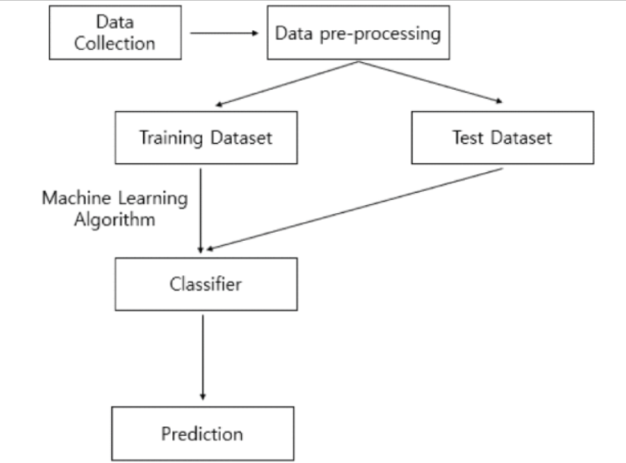
System Architecture

Slide 7
Data Description
It is a public set of comments collected for spam research. It has five datasets composed by 1,956 real messages extracted from five videos that were among the 10 most viewed on the collection period.
The collection is composed by one CSV file per dataset, where each line has the following attributes:
COMMENT_ID,AUTHOR,DATE,CONTENT,TAG
They contain YouTube ID, comment author, date, comment content, and labeled class (0: Ham or 1: Spam). We only use comment content and labeled class.

Slide 8
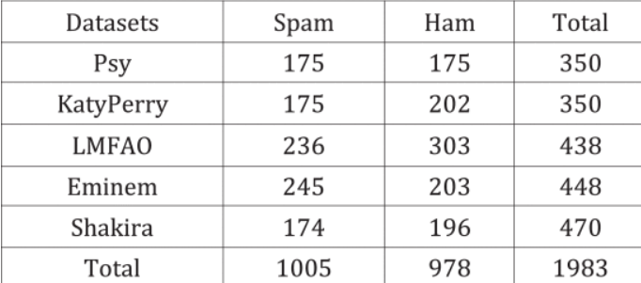
Data Description

Slide 9
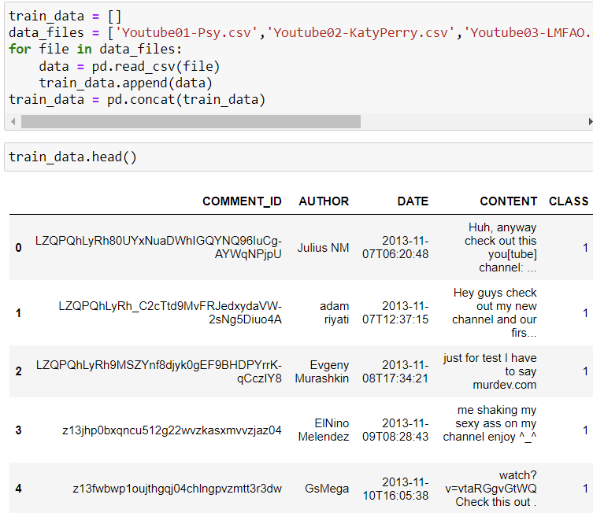
Implementation

Slide 10
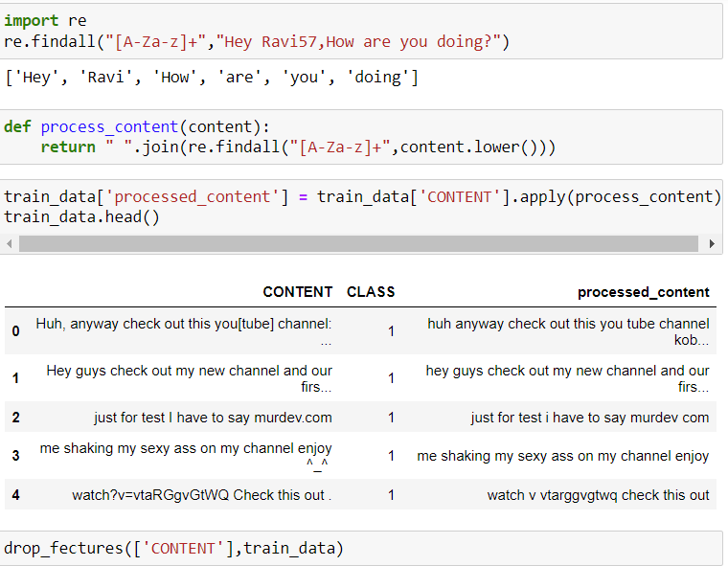
Implementation

Slide 11
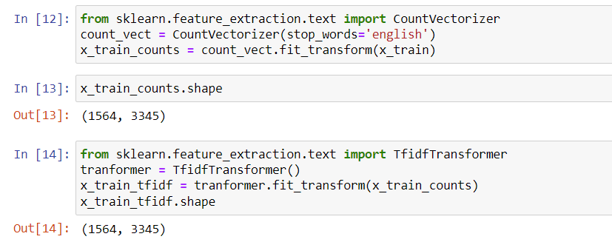
Implementation

Slide 12
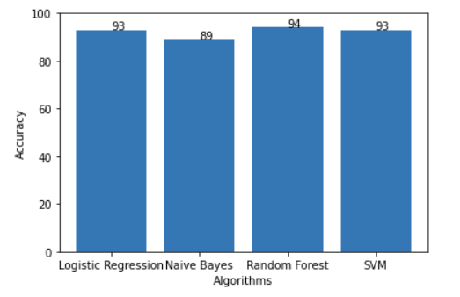
Result

Slide 13
Conclusion
With the growth of Youtube, there is a growth of Spam Comments on it too.
Youtubers don’t have the means to address that, but it can be addressed through data science and coding.
Through this project, I will try to do the same and hope to improve on the previously implemented projects.

